Slide 1
Indoor Air Quality

Slide 2

SUSTAINABLE JERSEY FOR SCHOOLS
Sustainable Jersey for Schools is a certification program for New Jersey public schools that want to go green, conserve resources and take steps to create a brighter future, one school at a time
Actions related to Indoor Air Quality:
  IAQ Review
  Process for reporting IAQ issues
  Classroom Cleanup protocols & practices

Slide 3
Perspective
“In the construction of buildings, whether for public purposes or as dwellings, care should be taken to provide good ventilation and plenty of sunlight….schoolrooms are often faulty in this respect. Neglect of proper ventilation is responsible for much of the drowsiness and dullness that….make teacher’s work toilsome and ineffective.”

Slide 4
Perspective
“In the construction of buildings, whether for public purposes or as dwellings, care should be taken to provide good ventilation and plenty of sunlight….schoolrooms are often faulty in this respect. Neglect of proper ventilation is responsible for much of the drowsiness and dullness that….make teacher’s work toilsome and ineffective.”
-Health Reformer, 1871

Slide 5
Did You Know……..
Americans spend 90% of their day indoors-in classrooms, offices, and at home.
90% of schools in the U.S. were built before 1980, and 50% of those before 1960.
Studies have indicated that indoor air often 5 to 10x dirtier and contain higher levels of contaminants than outdoor air.

Slide 6
Did You Know……..
Nearly 60 million students, and staff attend/work in our nation’s schools, representing about 20% of the population.
Recent data suggests that poor indoor air quality may directly reduce a person’s ability to perform specific tasks requiring concentration, calculation, or memory.
Asthma-related illnesses among students and staff is one of the leading causes of school absenteeism, accounting for 14 million missed school days per year.

Slide 7
What is Indoor Air Quality(IAQ)?
The Environmental Protection Agency(EPA) defines Indoor Air Quality(IAQ) as:
  The temperature, humidity, ventilation and chemical or biological contaminants of the air inside a building.
IAQ refers to the quality of the air inside buildings as represented by concentrations of pollutants and thermal (temperature and relative humidity) conditions that affect the health, comfort, and performance of occupants.

Slide 8
What is the significance of Indoor Air Quality(IAQ)?
'A' is for air.
People breathe air--REGULARY!
That alone makes IAQ a pretty important topic.
Most adults probably have a basic awareness that inhaling mold, mildew, asbestos, harsh chemicals, and other pollutants can have adverse health effects, especially for one's respiratory system.

Slide 9
What is the significance of Indoor Air Quality(IAQ)?
Growing children with developing lungs are especially sensitive to toxic environmental pollutants.
School-based exposure to poor IAQ can interfere with a student's ability to be present, ready, and able to learn.
Asthma, headaches, lethargy, nausea, drowsiness, and dizziness can be distracting.
Beyond producing acute symptoms and irritations, certain hazardous pollutants--referred to as 'air toxics'--are known or suspected to cause cancer over time.

Slide 10
Consequences of Poor IAQ?
  Increased potential for short and long term health issues.
  Decreased comfort, performance, and attendance.
  Accelerated deterioration and reduced efficiency of buildings and equipment.
  Increased potential for school closings/relocations.
  Strained relationships-Administration, staff, and parents.
  Negative publicity, decreased community trust, liability problems.

Slide 11
When did poor IAQ become a noticeable problem?
As a result of the energy crisis of the mid-1970s, IAQ complaints on the workplace dramatically increased for several reasons:
  The tendency toward tighter building envelopes and reduced ventilation to save energy.
  The growing proliferation of chemical pollutants in consumer and commercial products.
  Pressures to defer maintenance and other building services to reduce costs.

Slide 12
What Affects IAQ?
IAQ is not necessarily an easily understood concept.
It is a constantly changing interaction of a complex set of factors.
Problems occur in many types of buildings.
Problems reflect both comfort and health related issues.
Primary sources of IAQ problems include:
  Ventilation
  Contaminants generated indoors
  Infiltration of outdoor contaminants
  Unidentified sources

Slide 13
What Affects IAQ?
Ventilation Systems(HVAC)
  Mechanical heating, ventilating, and air-conditioning equipment:
    Designed to control indoor temperatures by supplying heated and cooled air.
    Dilute and remove airborne contaminants by providing a continuous supply of filtered outdoor air.
    Systems are designed to maintain a slight positive pressure in the building.

Slide 14
Basic Ventilation System

Slide 15
What Affects IAQ?
Indoor Contaminant Sources:
  Dust and Dirt
  CO2 (Primarily from Occupants)
  Perfumes, Colognes, Air-Fresheners
  Cleaning/Disinfecting Products
  Plants and Flowers
  Off gassing of new materials
  Mold (From intrusion of moisture)
  Stale air from unventilated areas
  Science and Art Supplies
  Rodent and Insect Activity

Slide 16
What Affects IAQ?
Outdoor Contaminant Sources:
  Exhaust vents located near make-up air intakes
  Vehicles idling near open windows and doors*
    *District anti-idling policy pending
  Pollen from outdoor plants
  Pollution from nearby facilities and construction
  Infiltration of general outdoor contaminants

Slide 17
What is Acceptable IAQ?
The American Society of Heating Refrigeration and Air conditioning Engineers, Inc. (ASHRAE) defines Acceptable Indoor Air Quality as:
  Air in which there are no known contaminants at harmful concentrations as determined by authorities and at which a substantial majority (80% or more) of the people exposed do not express dissatisfaction.

Slide 18
What is Acceptable IAQ?
Buildings exist to protect people from the elements and to otherwise support human activity.
Buildings should not make people sick, cause them significant discomfort, or otherwise inhibit their ability to perform.
However it must be understood that not all occupants may be "satisfied" with how effectively a building functions.

Slide 19
Health Effects of IAQ
  Varied and non-specific
  Health and comfort related:
    Personal temperature/humidity level preference
    Sensitivities to chemical or biological contaminants
    Unrelated health issues or stress
  Air monitoring does not always support their existence

Slide 20
Health Effects of IAQ
  Sick Building Syndrome-Building occupants experience acute health and comfort effects that are apparently linked to the time working indoors.
  Building-Related Illnesses-A relatively small number of occupants experience health problems accompanied by physical signs that are identified by a physician and/or laboratory findings, and can be attributed to environmental agents in the air.

Slide 21
Sick Building Syndrome (SBS) vs. Building-Related Illness (BRI):
Sick Building Syndrome
Building-Related Illness
Symptoms:
  Headaches
  Eye, nose, throat irritation
  Dry or itchy skin
  Fatigue
  Dizziness
  Nausea
  Loss of concentration
Symptoms:
  Eye, nose, throat, and upper respiratory tract irritation
  Skin irritation or rashes
  Chills, fever, cough, chest tightness, congestion, sneezing, runny nose
  Muscle aches

Slide 22
Sick Building Syndrome (SBS) vs. Building-Related Illness (BRI):
Sick Building Syndrome
Building-Related Illness
Symptoms:
  Do not fit the pattern of any particular illness
  Difficult to trace to a specific source
  Relief occurs upon leaving the building
Symptoms:
  Physical signs of exposure to chemical or biological substances
  Relief from illness may not occur upon leaving the building

Slide 23
Building-Related Illness:
Hypersensitivity Pneumonitis
Asthma
Chemical Sensitivity
Legionnaires’ Disease

Slide 24
How does the Facilities Department manage IAQ?
Proactive Element
  Preventive maintenance on buildings and equipment
  Proper cleaning procedures and practices
  Department Personnel and Staff Awareness Training
Reactive Element
  Prompt evaluation and correction of building and equipment breakdowns.
  Investigation of all IAQ concerns/complaints to resolve issues.
Compliance Element
  Adherence to all local, state, federal standards and laws relating to IAQ in schools.

Slide 25


PEOSH IAQ Standard
N.J.A.C. 12:100-13 et seq.
PEOSH-Public Employee Occupational Safety and Health
Enforced by NJDOHSS/NJDOL
Adopted in 1998, First IAQ Standard in U.S.
Revised in 2007, PEOSH Advisory
Board, IAQ Subcommittee
  Designated Person
  Written IAQ Program
  48 Hrs to remove damp materials

Slide 26
PEOSH IAQ Standard
N.J.A.C. 12:100-13 et seq.
13.1 Scope
13.2 Definitions
13.3 Compliance Program
13.4 Control of Specific Contaminant Sources
13.5 Air Quality During Renovation & Remodeling
13.6 Recordkeeping
13.7 Employer’s Response to Complaints
13.8 IAQ Compliance Documents

Slide 27
PEOSH IAQ Standard
N.J.A.C. 12:100-13.1
Scope:
This subchapter shall apply to matters relating to indoor air quality in buildings occupied by public employees during regular work hours.

Slide 28
PEOSH IAQ Standard
N.J.A.C. 12:100-13.2
Definitions (selected):
"Designated person" means a person who has been given the responsibility by the employer to take necessary measures to assure compliance with this subchapter.
"Office building" means a building in which administrative, clerical or educational activities are conducted. Examples of facilities and/or operations, which are not office buildings, include repair shops, garages, print shops and warehouses.

Slide 29
PEOSH IAQ Standard
N.J.A.C. 12:100-13.2
Definitions (selected):
“HVAC system" means the collective components of the heating, ventilation and air-conditioning system including, but not limited to, filters and frames, cooling coil condensate drip pans and drainage piping, outside air dampers and actuators, humidifiers, air distribution ductwork, automatic temperature controls, and cooling towers.
"Renovation and remodeling" means building modification involving activities that include but are not limited to: removal or replacement of walls, roofing, ceilings, floors, carpet, and components such as moldings, cabinets, doors, and windows; painting; decorating; demolition; surface refinishing; and removal or cleaning of ventilation ducts.

Slide 30
PEOSH IAQ Standard
N.J.A.C. 12:100-13.3
Compliance Program:
  Employer shall identify and train a “Designated Person”
    A person given the responsibility (and authority) by the employer to take measures to assure compliance

Slide 31
PEOSH IAQ Standard
N.J.A.C. 12:100-13.3
Compliance Program:
  Employer’s designated person shall:
    Establish and follow a preventative maintenance schedule
    Ensure that damaged or inoperable components are replaced or repaired promptly
    Implement the use of general or local exhaust ventilation
    Check the HVAC system when carbon dioxide levels exceed 1,000 ppm

Slide 32
PEOSH IAQ Standard
N.J.A.C. 12:100-13.3
Compliance Program
  Employer’s designated person shall:
    Check HVAC system if temperature range is outside 68°F-79°F
    Prevent contamination of fresh air supply
    Check that natural ventilation portals are maintained
    Promptly investigate all employee concerns/complaints about IAQ
    Prepare written plan (including required components)
    Review and update written plan annually

Slide 33
PEOSH IAQ Standard
N.J.A.C. 12:100-13.4
Control Specific Indoor Contaminants
  Microbial Contaminants
    Promptly repair water intrusion that can promote biological growth
    Remediate damp/wet material by drying or removal within 48hrs of discovery and continue until water intrusion is eliminated
    Remove visible microbial contamination

Slide 34
PEOSH IAQ Standard
N.J.A.C. 12:100-13.5
Renovation and Remodeling:
  Evaluate chemical hazards
  Notify employees 24 hours prior to any construction
  Utilize local exhaust ventilation
  Isolate construction areas (scheduling, physical barriers, pressure differentials)
  Construction areas required to be cleaned and aired out as necessary prior to re-occupancy

Slide 35
PEOSH IAQ Standard
N.J.A.C. 12:100-13.6
Recordkeeping
  Required Records
    Written IAQ Program
    Documentation of Designated Person Training
    Written Preventive Maintenance Program
    Preventive Maintenance Log

Slide 36
PEOSH IAQ Standard
N.J.A.C. 12:100-13.6
Recordkeeping
  Requirements:
    Maintained for 3 years
    Available to employees and representatives
    for examination and copying ASAP or within
    10 working days
    Available immediately during PEOSH inspection

Slide 37


Slide 38
PEOSH IAQ Standard
N.J.A.C. 12:100-13.7
Employer’s Response to Signed PEOSH Complaint:
PEOSH will send letter to employer for a response:
  Designated Person will respond within 15 days
    Provide statement that the complaint is NOT founded and/or
      Study of Issue initiated and completion date
      Remediation measures already completed
      Remediation planned and completion time

Slide 39
PEOSH Program Response to Unacceptable IAQ
On-site Inspection
Conduct Employee Interviews
Review Building Operations & Maintenance Procedures
Walk-through inspection of the building
Inspect HVAC System
Review As-builts construction plans of the building
Conduct Air Sampling, if necessary
Complete PEOSH IAQ Checklist
Remediation Plan, follow up re-inspections

Slide 40
PEOSH IAQ Standard
N.J.A.C. 12:100-13.8
IAQ Compliance Documents
    As-built construction documents
    HVAC System Commissioning Report
    HVAC Systems Testing, Adjusting, and Balancing Reports
    Operations and Maintenance Manuals
    Water Treatment Logs
    Operator Training Materials
Must be provided to PEOSH, upon request (if available)

Slide 41
Other Standards Related to IAQ
(Overview)
PEOSH General Industry (29 CFR 1910.1001) and Construction (29 CFR 1926.1101) Asbestos Standards
  Identification of asbestos-containing materials in all buildings (pre-1980)
  Labeling and signage requirements
  Annual awareness training
  Notification of outside contractors
Other Federal and State Asbestos Standards
  Schools (AHERA)-U.S. EPA/NJDHSS
  NJ Uniform Construction Code-Subchapter 8,
  NJ Dept. of Community Affairs (NJDCA)

Slide 42
Additional IAQ Resources
PEOSH Publications
http://nj.gov/health/peosh/iaq.shtml
Public Employer’s Guide and Model Written Program for the Revised Indoor Air Quality Standard
  PEOSH Policy on Building Renovations Information Bulletin
  Renovation & Construction in Schools-Controlling Health and Safety Hazards Information Bulletin
  Bioaerosols Information Bulletin
  Mold in The Workplace, Prevention and Control Information Bulletin

Slide 43
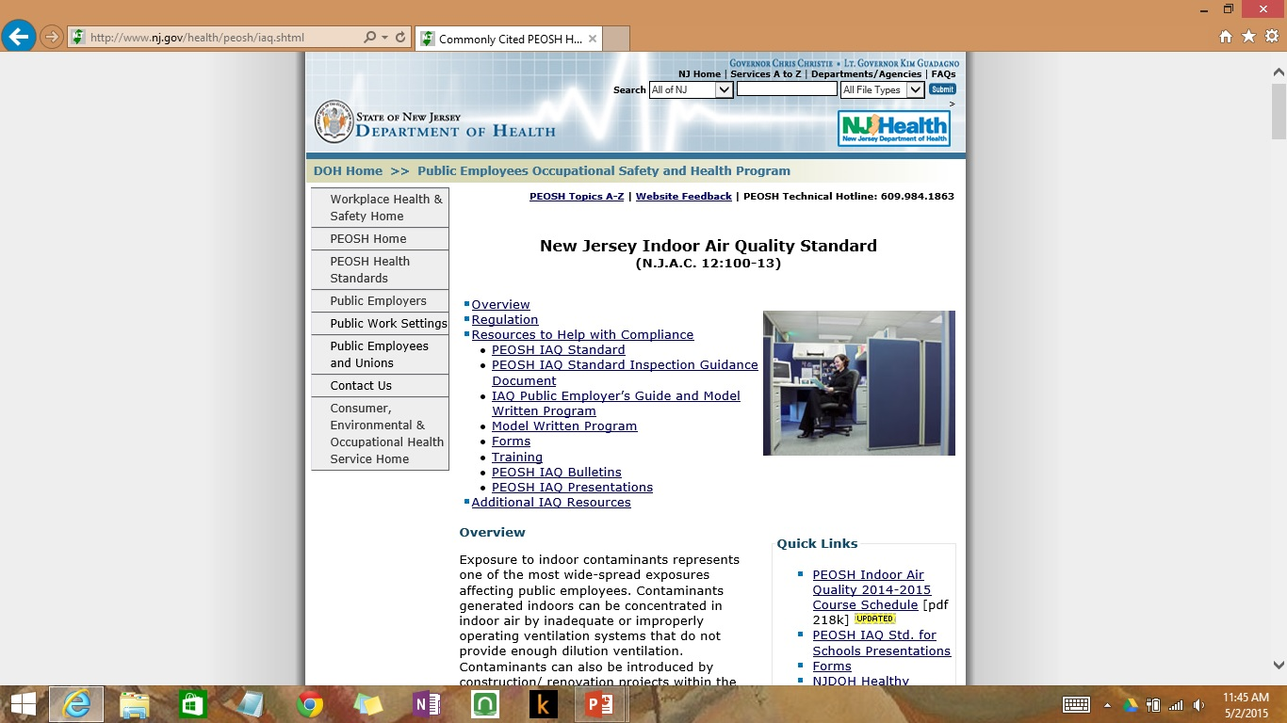
http://nj.gov/health/peosh/iaq.shtml

Slide 44
How can staff assist with IAQ?
There are some things that, teachers, staff, and other personnel can do to help improve the indoor air quality in our classrooms and school.
Recognizing that proper building maintenance is a school department function, there are some suggestions that we’d like to offer to help enhance those efforts.

Slide 45
How can Staff assist with IAQ?
Ventilation:
  Allow ventilation units to run continuously, keeping grilles and diffusers clear of obstructions.
  Keep thermostats clear of obstructions or heat generating equipment.
  Promptly report any ventilation equipment related issues( noises, odors, temperature control, air-flow problems, comfort).
Potential Contaminants:
  Do not bring in or use cleaning products, air fresheners, candles, pesticides from home.
  Promptly report water leaks, moisture on surfaces, mold, pest activity.
Cleanliness:
  Store loose items in containers to reduce clutter in the classroom.
  If possible, limit the use of upholstered furniture, throw pillows, stuffed animals as they collect dust.
  Ensure that spills(especially on carpets) are cleaned promptly.

Slide 46
How can Staff report an IAQ concern?
Fill out IAQ Concern Form and send to Facilities Manager
  Forms are available in the main office of each building, and on the Facilities page of the school website.
  Regardless of how minor the concern may be, it will be investigated
Follow up Investigation by Facilities Manager
  Go to the location(s) of concern
  Conduct interviews
  Review building operations and maintenance procedures
  Complete PEOSH IAQ Inspection/Walkthrough Checklist
  Involve employees through PEOSH if needed
  Communicate outcome and corrective action

Slide 47

Facilities Webpage:

Slide 48
Questions?

