Slide 1
Do Now
Please write your HW in your agenda!
Please update your table of contents.
Please take a foldable template and 2 strips of paper (in the color of your choosing) from the cart!
Page # | Title
10 | Lab Tool Homework

Slide 2
Tonight’s Homework
On pg 10 of your notebook, please tape/glue the HW instructions at the top.
You will choose one of the lab tools we are learning about and write about its uses in TWO different scientific fields.
Example: An Erlenmeyer flask is used in biology for… It is used in chemistry for…

Slide 3
Lab Tools Foldable
You should have a foldable template and 2 strips of paper (in the color of your choosing) from the cart!
This foldable can be difficult to make, so please give Mr. Lerner your full attention!
There will be a looped step-by-step slideshow on the board while you work.

Slide 4
Lab Tools Card Sort
You will receive a pack of cards with pictures, names, and functions of the lab tools you met yesterday.
With your table, attempt to match them up by building 3 columns:
You will have 5 minutes!
Picture | Name | Function

Slide 5
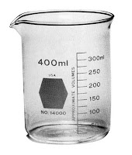
Beaker
Container for stirring, heating, and mixing various amounts of liquids

Slide 6
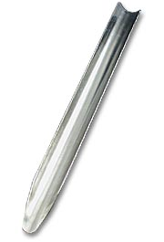
Scoopula
A utensil used to transfer solids

Slide 7
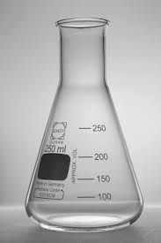
Erlenmeyer flask
Cone-shaped flask used to stir by swirling it or stoppered by a rubber stop

Slide 8
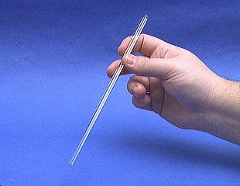
Stirrer
Used for stirring liquids

Slide 9
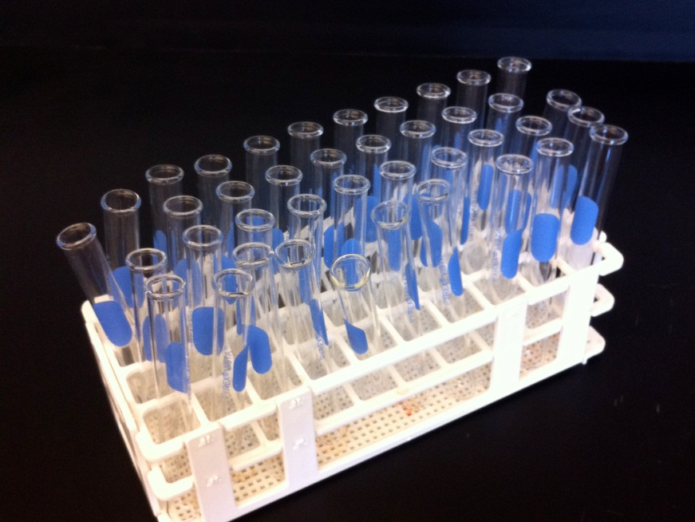
Test tubes (in test tube rack)
Used to hold, heat, or mix small amounts of liquids
Rack holds test tubes

Slide 10
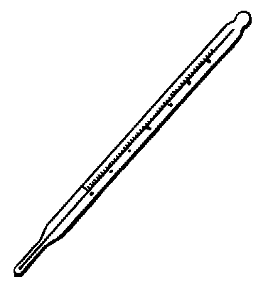
Thermometer
Used to take a substance’s temperature in degrees

Slide 11
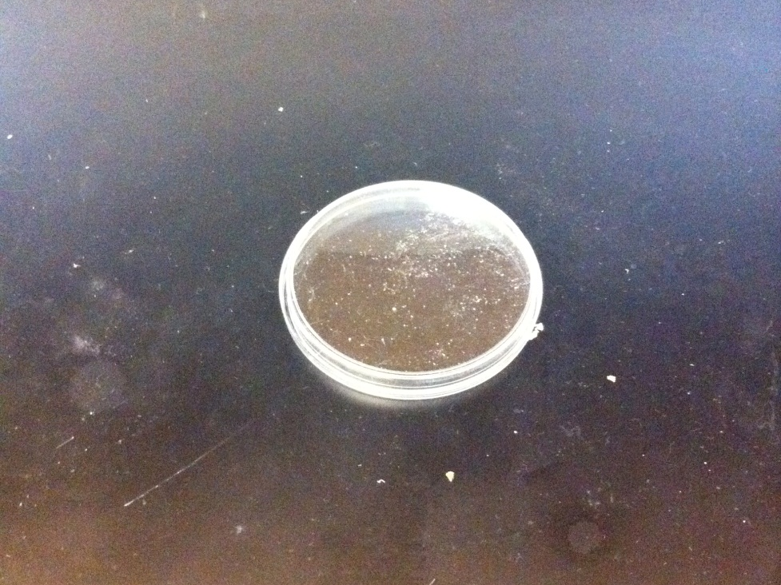
Petri dish
Used to grow cell culture or for observation of other substances

Slide 12
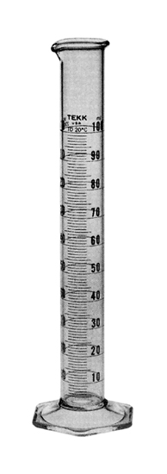
Graduated cylinder
Used to accurately measure the volume of a liquid or solid

Slide 13
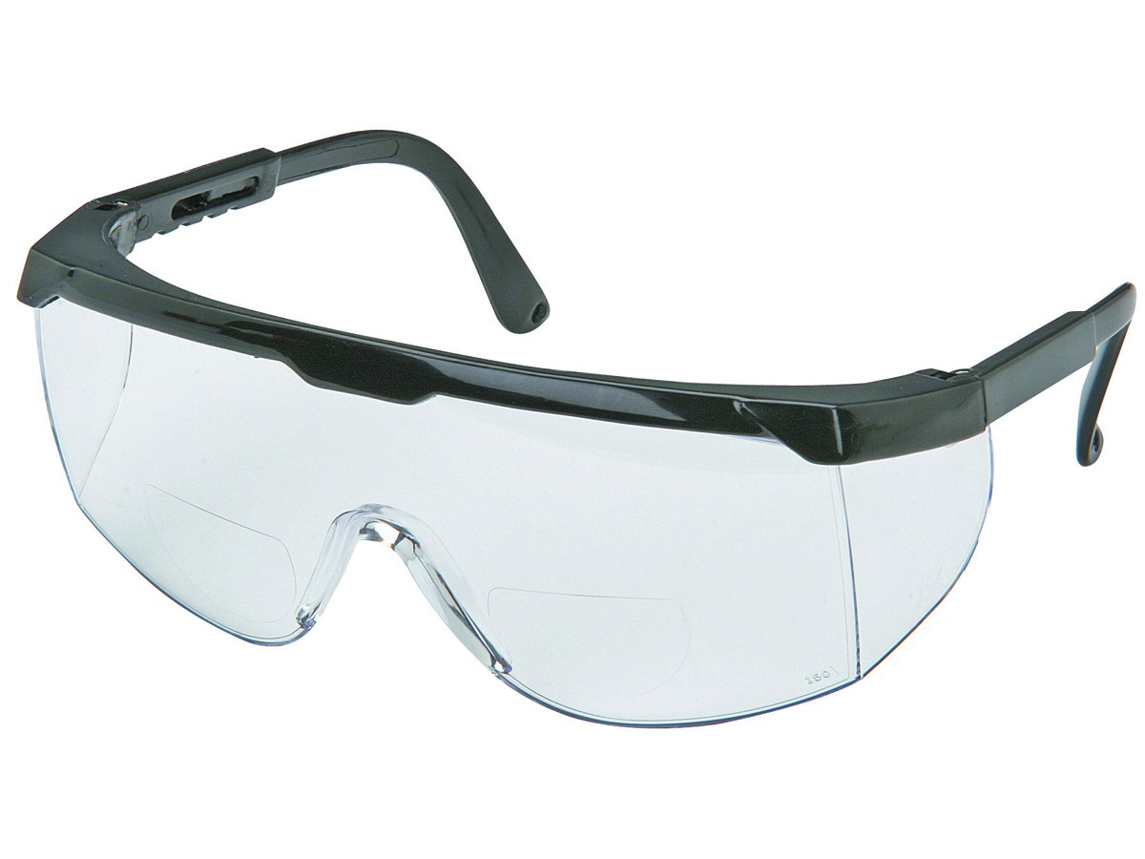
Safety Goggles
Used to protect the eyes from substances

Slide 14
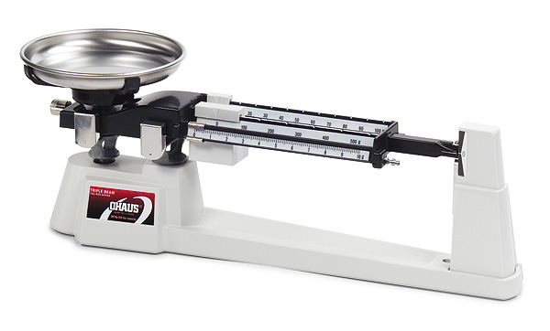
Triple beam balance
Used to measure mass of various substances

Slide 15
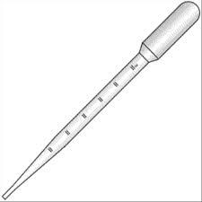
Pipette
Used to transfer small amounts of liquid

Slide 16
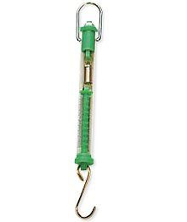
Spring scale
Used to measure force in Newtons

Slide 17
Lab Tools Foldable
Using your now correctly sorted cards, please fill in the foldable with the names of the lab tools and their uses.
Names should be written next to the image of the lab tool – when the foldable is “closed.”
Uses should be written on the inside of the foldable – when it is “open.”

Slide 18
➔
⬅
Closed
Open

